Slide 1
SNA FOR NBA
PavanKumar – MB22022

Slide 2
TABLE OF CONTENTS
01
02
03
04
Introduction and Motivation
Problem Statement
Data, Analysis and results
Discussion and Conclusion

Slide 3
-Pat Riley
Most teams aren’t that analytical

Slide 4
INTRODUCTION
Here you give a brief intro of the topic you want to talk about. For example, you can talk about Mercury
In realm of sports activities analytics, basketball is at the leading edge of information-pushed insights.
The "BasketballAnalyzeR" library acts as our compass, navigating the ocean of ​​statistics to find out hidden patterns and styles. Join us as we discover how this effective device is revolutionizing basketball analytics, shaping the future of the sport

Slide 5

Motivation
The motivation at the back of using the "BasketballAnalyzeR" library is to leverage statistics analytics a good way to gain a competitive gain and optimize performance in the realm of basketball. By delving into the intricacies of participant records, team dynamics, and game techniques, we goal to unencumber treasured insights which could tell choice-making, enhance participant improvement, and ultimately elevate the overall pleasant of play.

Slide 6
OUR METHOD
ACTIVITIES
FEEDBACK
Utilize the "BasketballAnalyzeR" library to analyze player performance and team strategies.
Gather insights from data analysis to inform coaching decisions and player development strategies.
GOALS
EVALUATION
Optimize player performance, enhance team dynamics, and improve overall competitiveness.
Assess the effectiveness of implemented strategies and identify areas for improvement through continuous data-driven evaluation.

Slide 7
02
Problem Statement
Maximizing the potential of basketball data for performance optimization and strategic decision-making remains a challenge, highlighting the need for a user-friendly analytics tool tailored to the sport's unique dynamics.

Slide 8



Methods
Social Network Analysis
Applying social network analytics techniques to analyze the interactions and relationships within basketball teams.
R Language
Graphs
Utilizing the R programming language for data analysis and visualization.
Creating graphical representations to visually depict the insights derived from the data analysis and social network analytics.

Slide 9
Data
INTRODUCTION
30 Teams
Data we used for this analysis comprises of 2 sets
There were 30 teams who played in the year 2018-19 session of NBA. Where Golden states were champions in Western Conference
Data
30 Teams data
605 individual players
Players
There were 605 teams total played in this session where analysis on golden state warriors and Celtic players are being performed

Slide 10
Analysis
We employed the 'BasketballAnalyzeR' device to calculate the average percent of three-guidelines and -pointers made by NBA groups. Notably, the Golden State Warriors show off the best chances for both three-suggestions and recommendations, distinguishing them as a standout team of the league. Conversely, the Phoenix Suns display the bottom percentages for both classes. This commentary suggests that teams placed in Quadrant 2 may be experiencing a a hit season, whereas the ones in Quadrant four can be dealing with challenges.

Slide 11
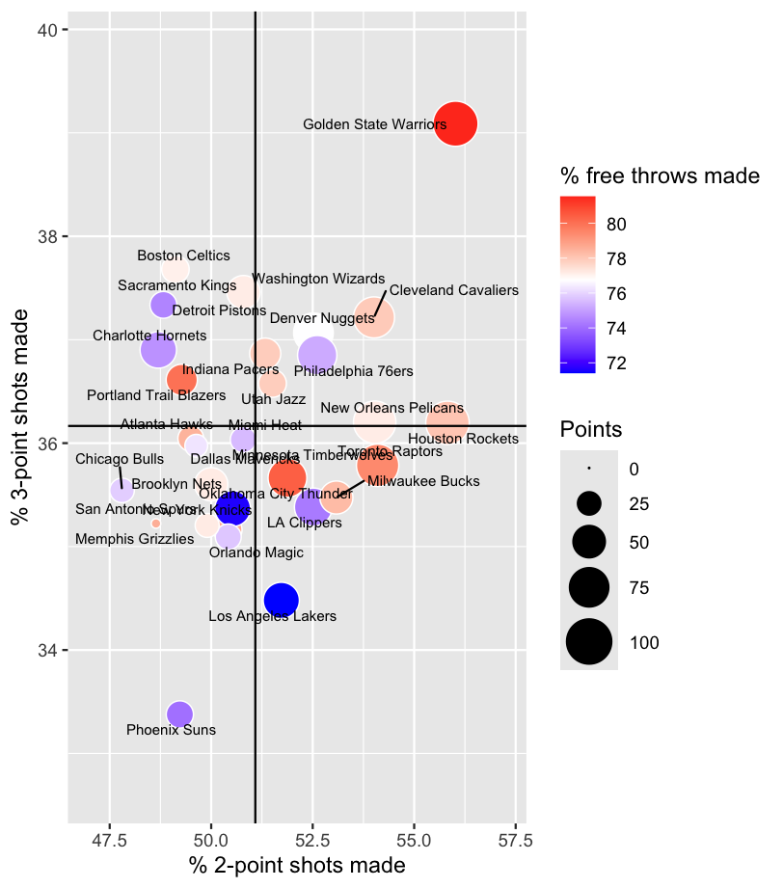
The graphs depict the performance of all NBA teams in terms of the percentage of two-pointers and three-pointers scored during competitions.

Slide 12
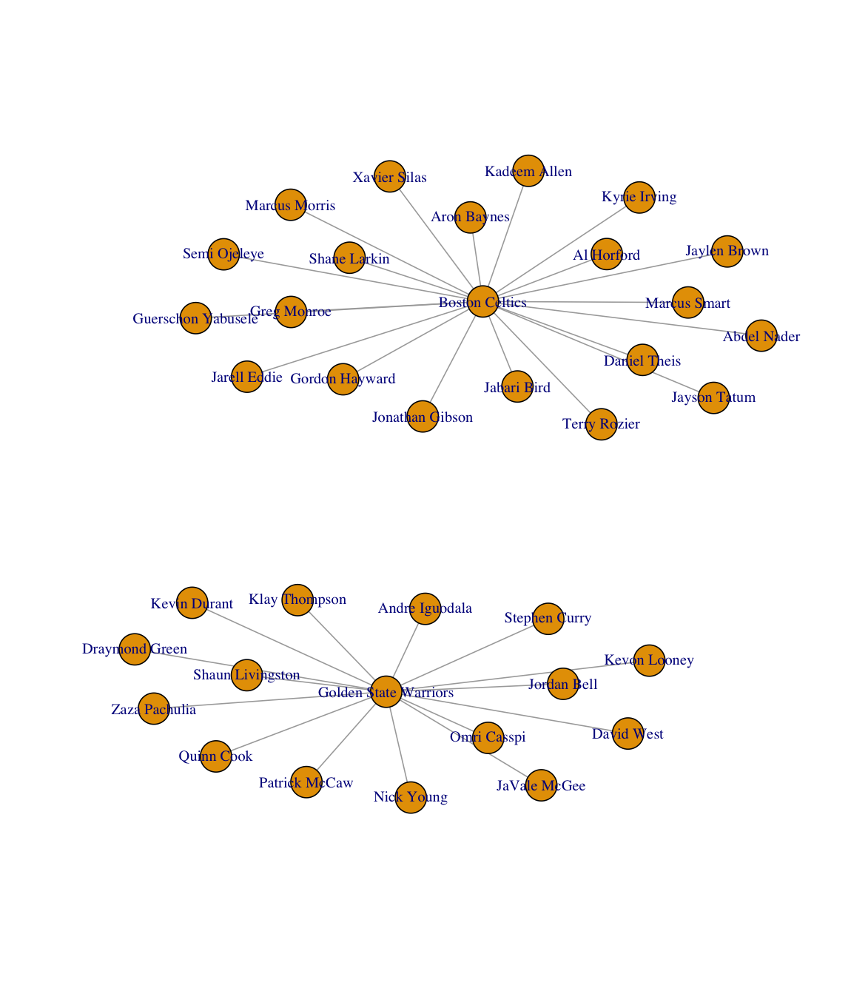


Social Network Analysis
For our social community evaluation (SNA), we applied community analytics to study participant usage tendencies throughout teams within the cutting-edge season. Specifically, our analysis specializes in two distinguished NBA teams: the Golden State Warriors and the Boston Celtics.
GOLDEN STATE WARRIORS
Boston Celtics

Slide 13
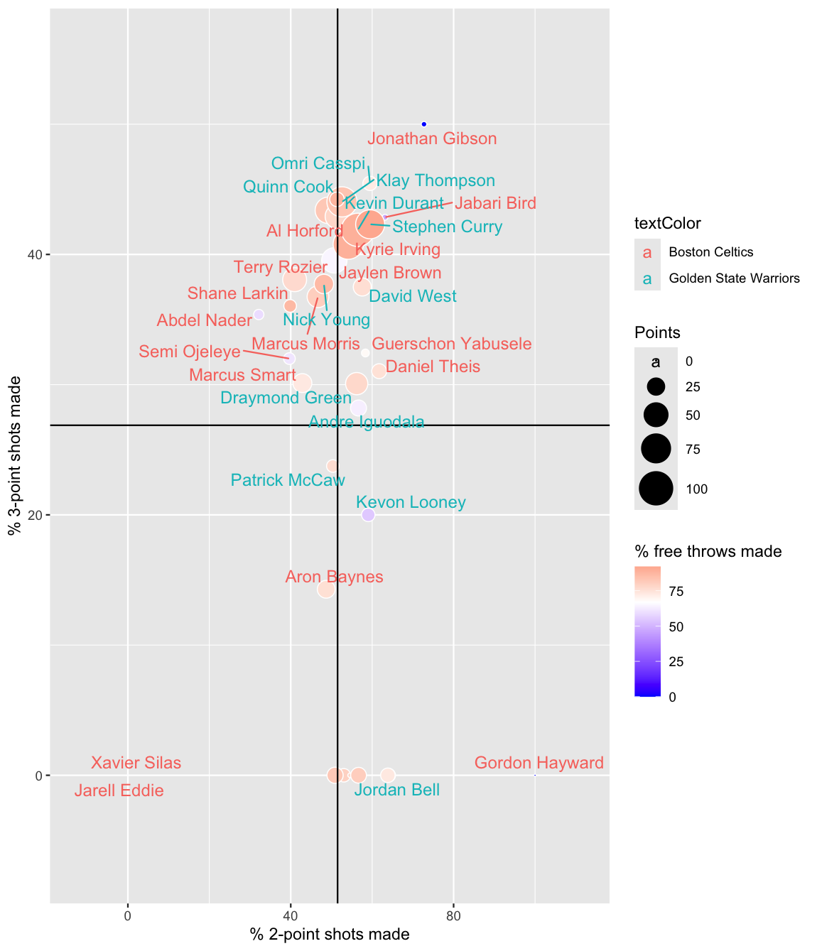


Social Network Analysis
Now, we embark on a comparative evaluation of participant overall performance among the Golden State Warriors and the Boston Celtics in the NBA.

Slide 14
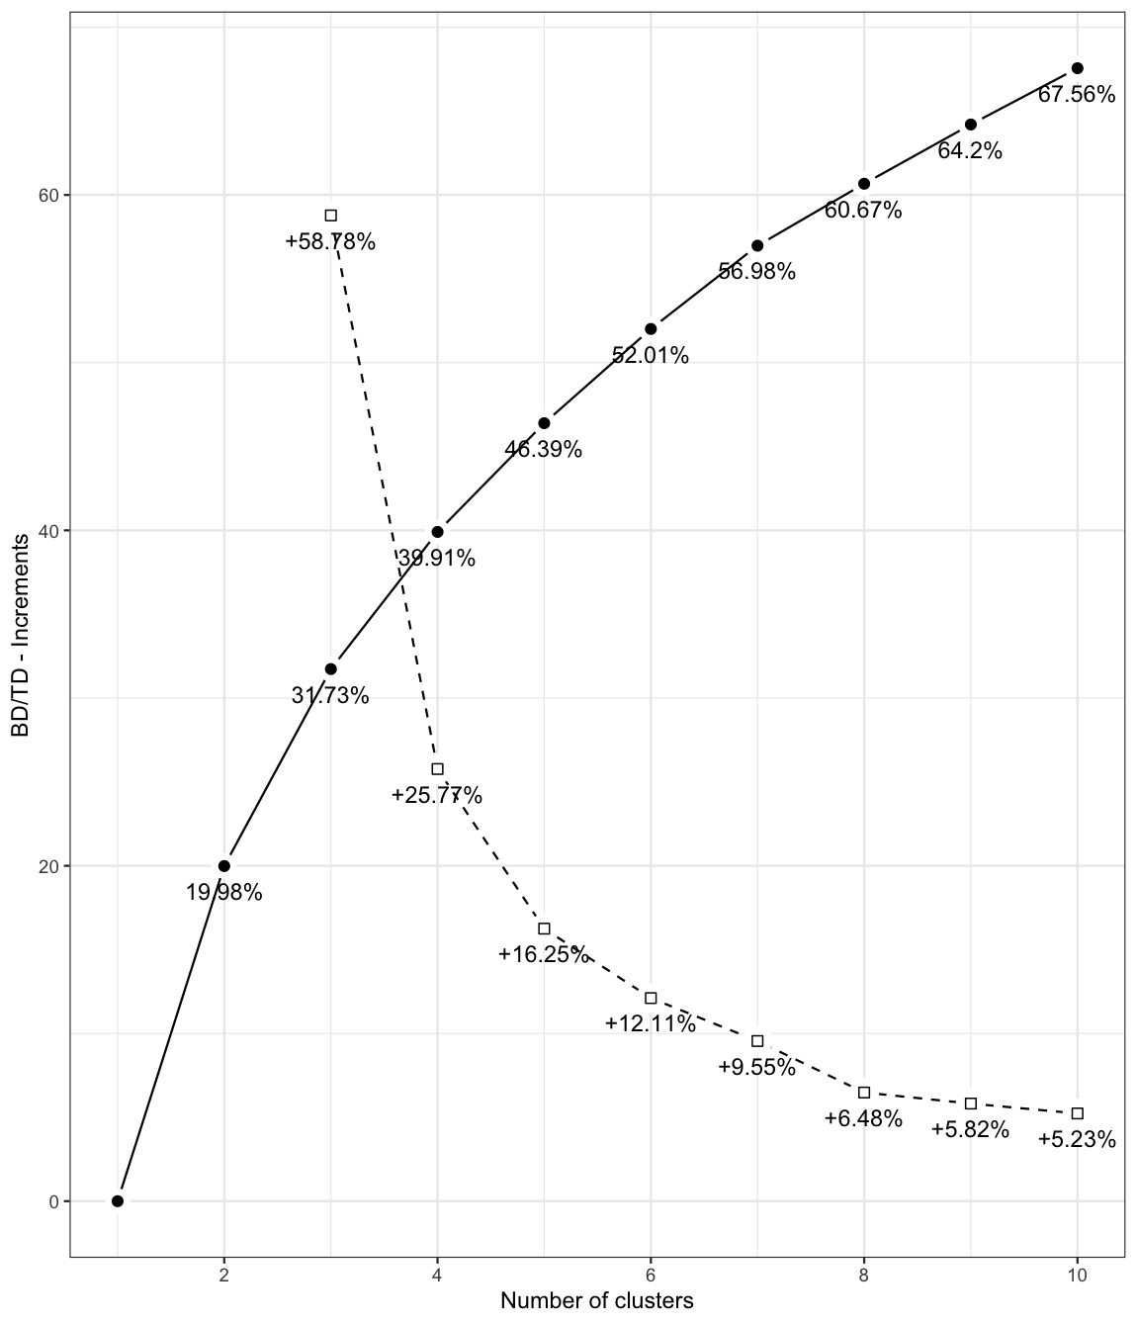
Graphs
X-axis: Number of clusters. Y-axis: BD/TD ratio, measuring between-cluster variability.
BD captures variability between clusters, while TD represents total variability.
Increasing clusters raises BD, showing better grouping with higher between-group variance.
Initially, significant BD increase; later, diminishing returns as shown by dotted lines.

Slide 15
Discussion and Conclusion
Optimized Player Roles: Utilizing clustering analysis enables teams to become aware of participant organizations with complementary capabilities, facilitating more effective role assignments and cohesive line-up formations.
Tailored Training Strategies: In-intensity analysis of variability within and among clusters empowers teams to tailor education packages to cope with specific performance needs, fostering stepped forward crew synergy.
Strategic Recruitment: Insights gleaned from cluster evaluation inform recruitment strategies, guiding teams in selecting gamers who seamlessly integrate into existing team dynamics or fill vital overall performance gaps.
Enhanced Competitiveness: Through records-driven selection-making, teams can liberate participant capacity and elevate usual team performance, resulting in heightened competitiveness and extended probability of fulfillment on the court docket.

Slide 16

Thankyou

